Slide 1




Introduction to direct nuclear reactions
Young-Ho Song
2021.02.22~26
라온활용학교 @ on-line
https://indico.ibs.re.kr/event/403/

Slide 2

01
1. 일반현황
사업개요 및 내용
사업 일반현황
사업 개요 및 내용
CONTENTS
PART 1. Introduction
PART 2. DWBA and Coupled Channel method
PART 3. Elastic, Inelastic, Transfer
PART 4. Break up, CDCC, ADWA
PART 5. Knock out, Fusion
PART 6. Summary

Slide 3

Part 1.
Introduction

Slide 4
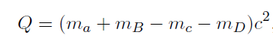
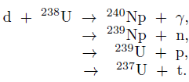
Nuclear Reaction
1. Introduction
B(A, C)D
target
projectile
Projectile
like
Target
like
Reaction Q-value:
Conservation laws in nuclear reaction
Baryon Number
Charge
Energy and linear momentum
Total angular momentum
Parity
(approximate) Isospin
(Released energy)

Slide 5
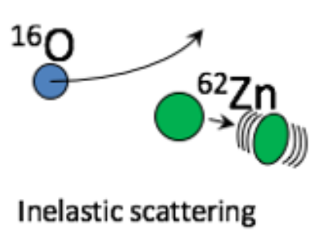
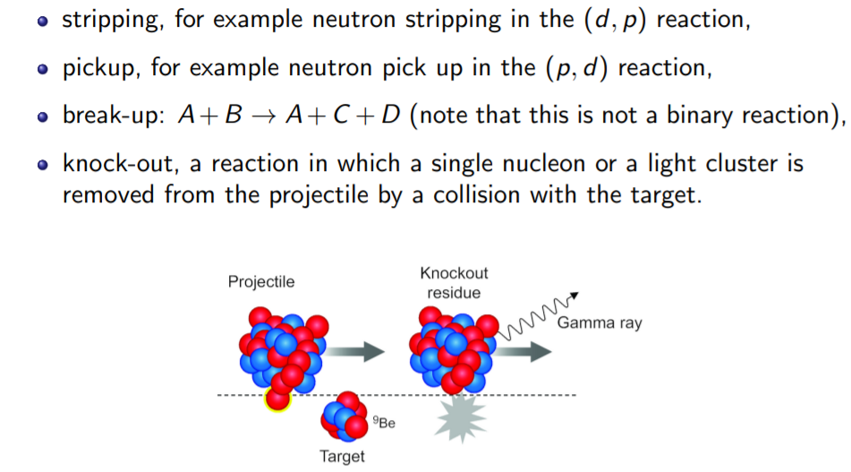
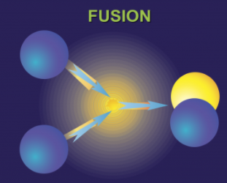
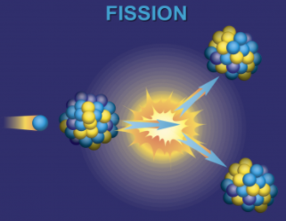
Nuclear Reaction
1. Introduction
Types of reactions
(according to reaction products)
Elastic
Inelastic
Rearrangement(transfer)
Fusion, capture
Fission

Slide 6
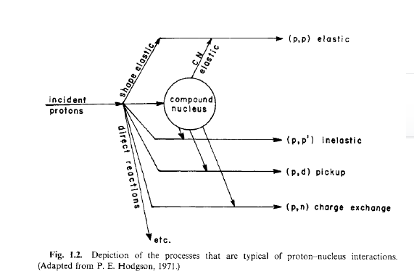
Nuclear Reaction
1. Introduction
Types of reactions
(reaction nature, time,
energy transfer)
Direct
Compound
Direct Reaction : glancing contact, immediate separation,
near the nuclear surface, large impact parameter,
short time scale
strongly forward peaked
interact with only few nucleons or nucleus as a collective whole

Slide 7
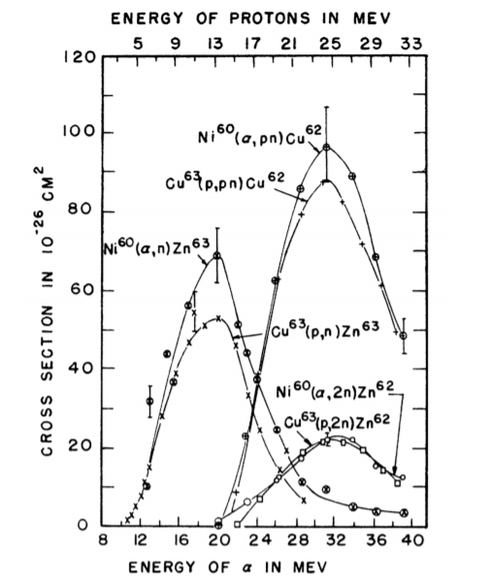
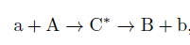
Nuclear Reaction
1. Introduction
Types of reactions
Direct
Compound
Compound Reaction : slow, massive energy sharing,
involve all projectile + target
fusion, decay. Isotropic
thermal equilibrium,
independence hypothesis.

Slide 8
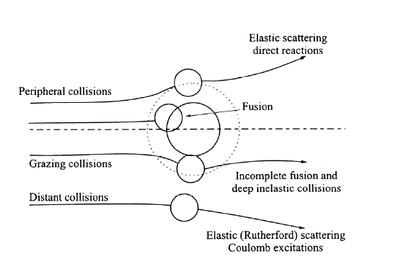
Nuclear Reaction
1. Introduction
Types of reactions
(according to position of reaction)
Distant
Peripheral
Grazing
Types of reactions
(energy release)
Exothermic
Endothermic
Elastic

Slide 9
Nuclear Reaction
1. Introduction
Here we only consider direct reactions.
Direct reaction is an important tool
to study nuclear interaction, structure and astrophysics.
elastic scattering: average strength of interaction, size of target
Inelastic scattering: Excited states (Energy, angular momentum, parity)
Rearrangement reaction: spectroscopic information
one-nucleon transfer: single particle level
two-nucleon transfer : correlation of two nucleons

Slide 10
Nuclear Reaction
1. Introduction
In principle, nuclear reaction is a many-body problem and
It is very difficult to solve exactly (even when interactions are known).
Thus, usually the problem is approximated as an easier few-body problem.
Ignore internal degrees of freedom
or use a simple model of nuclear structure
There are many direct nuclear reaction codes available.
In this lecture, we focus on Elastic, Inelastic, transfer … reactions
in simple structure/reaction models
And explain how to calculate the reaction cross section in practice.
(Also how to use some nuclear reaction codes)

Slide 11
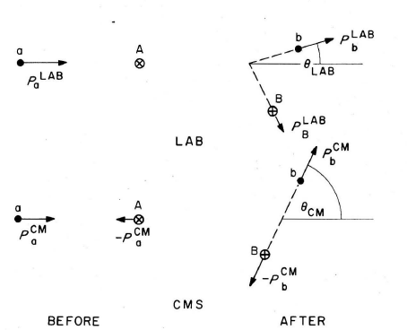
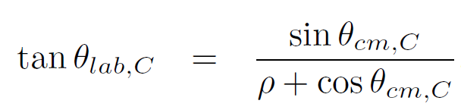
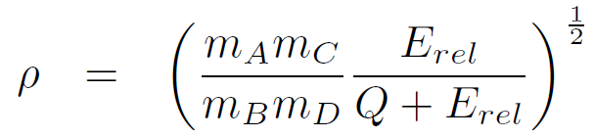
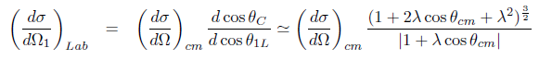
Kinematics
1. Introduction
Typically, two body reactions.
Theoretical calculations are done in
Center of mass frame.
Need convert CM<->LAB
(Satchler fig2.1)

Slide 12
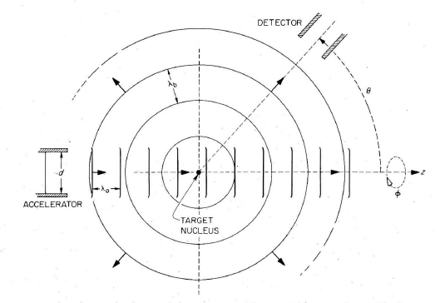
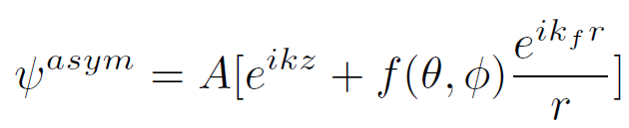
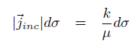
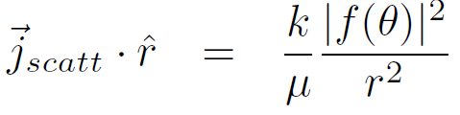
Short review Scattering theory
1. Introduction
If interaction have finite range,
Asymptotic boundary condition
Incident wave + scattered wave
f : Scattering amplitude
f=0 , if there is no potential
(Satchler Fig. 3.1)
Then incident flux and scattered flux at large distance

Slide 13
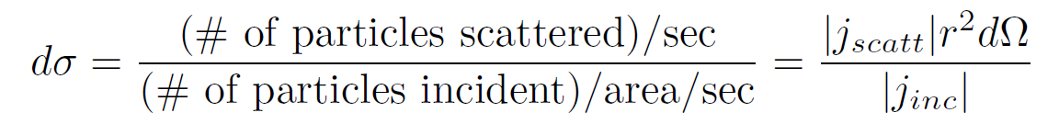
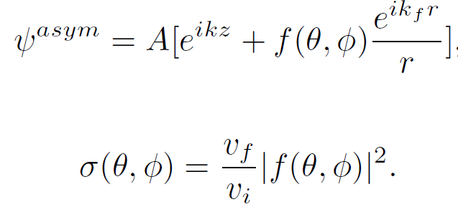
Short review Scattering theory
1. Introduction
(Number of particles detected in solid angle)
= (Number of incident particles)*(effective area)/(incident area)
= (Number of incident particles)/(incident area)
*(effective area per target)*(number of target in area)
Cross section does not depends on the experimental condition
Cross section for the scattering into solid angle
Differential Cross section

Slide 14
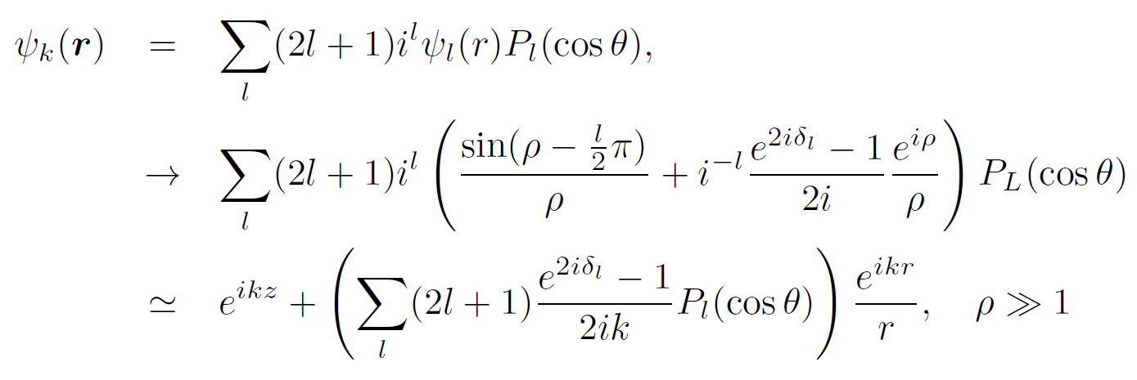
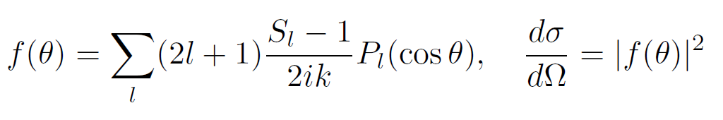
Short review Scattering theory
1. Introduction
Partial wave expansion→ phase shift, S-matrix, T-matrix

Slide 15
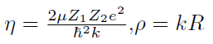
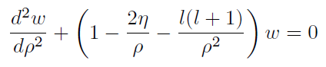
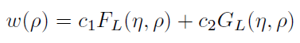
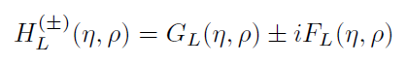
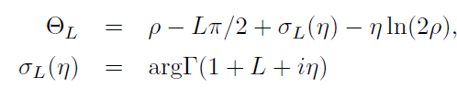
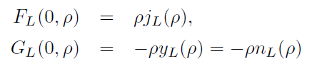
Short review Scattering theory
1. Introduction
Coulomb Scattering
Sommerfeld parameter
Free particle wave function
Spherical Bessel (Neumann) function
with eta=0, V=0
Coulomb phase shift

Slide 16
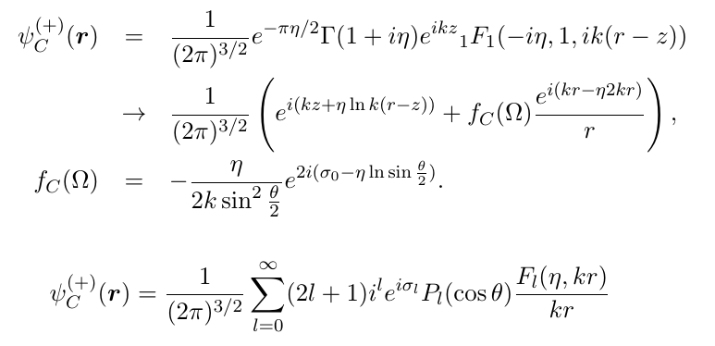
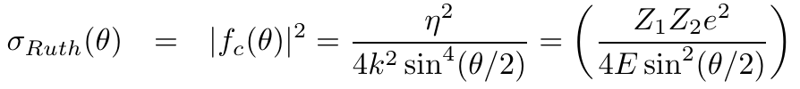
Short review Scattering theory
1. Introduction
Coulomb Scattering

Slide 17
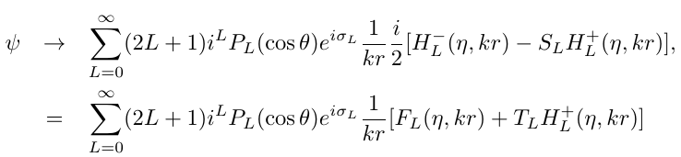
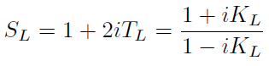
Short review Scattering theory
1. Introduction
Coulomb + Nuclear Scattering
Nuclear S-matrix, phase-shift
Nuclear S-matrix is not the same as the phase shift without Coulomb interaction.
Coulomb phase shifts are included in the
Coulomb wave functions.

Slide 18
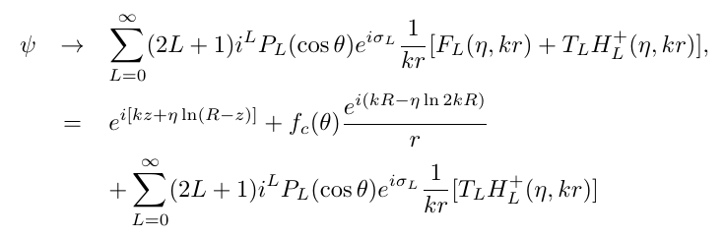
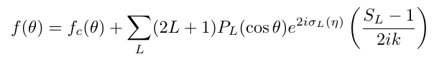
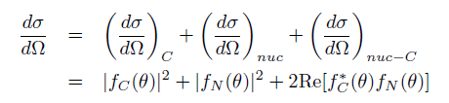
Short review Scattering theory
1. Introduction
Coulomb + Nuclear Scattering
Full phase shift= (Coulomb phase shift)+ (Nuclear phase shift)
For Coulomb scattering, one have to use
(fully summed) Coulomb scattering amplitude form.
For nuclear scattering amplitude, partial wave expansion is usually good.
(truncate L <- short range of nuclear interaction)
Interference between Coulomb and nuclear scattering amplitude.

Slide 19
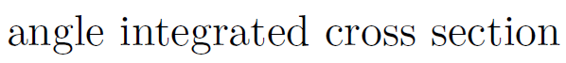
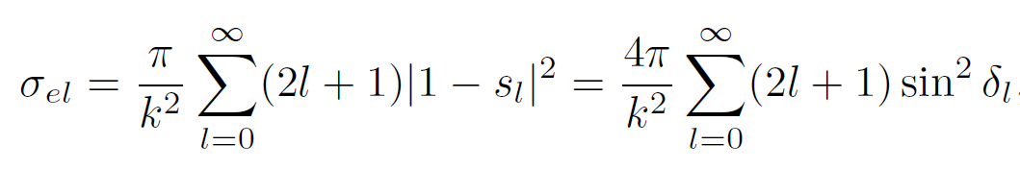
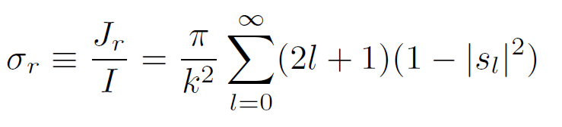
Short review Scattering theory
1. Introduction
(total cross section) = (elastic cross section) + (reaction cross section)
(reaction cross section) describe the disappearance of flux from elastic channel
~ (absorption )
Reaction cross section = ratio between (incident flux) and (disappeared flux)
For strong absorption: s=0 for L<Lmax, s=1 for L> Lmax,
R_max ~ L_max/k
sigma~ pi*Lmax^2/k^2 ~ pi *R^2

Slide 20
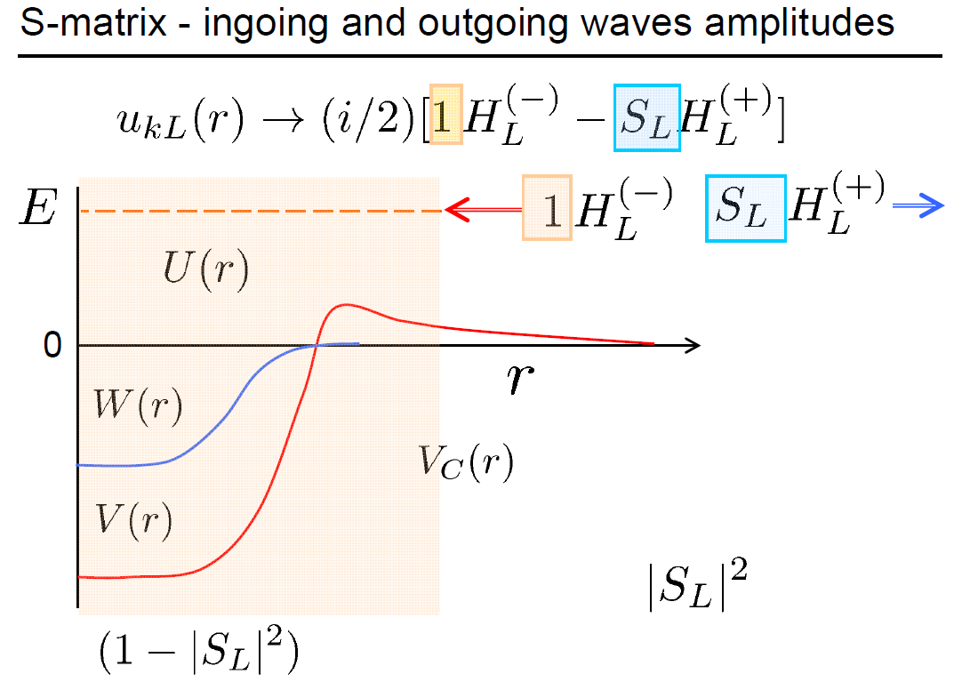
Short review Scattering theory
1. Introduction
One can interpret
S-matrix as a
Reflection coefficient.
Probability of Reflection
Probability of absorption/transmission
(Figure from J.Tostevin’s slide)

Slide 21
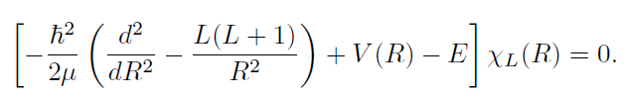
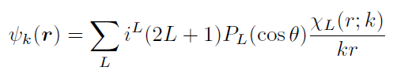
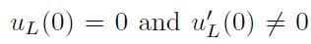
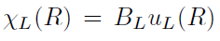
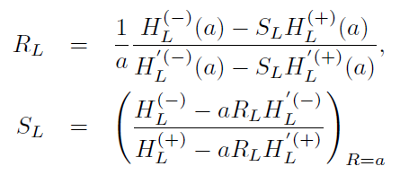
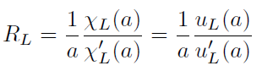
Short review Scattering theory
1. Introduction
How to get S-matrix, phase shift ?
Solve Schrodinger equation with interaction for wave function
Extract S-matrix, phase shift from the asymptotic form of the solution.
Get Numerical Solution of Schrodinger equation (Runge-Kutta, Numerov…)
With boundary condition

Slide 22
Part 1.
DWBA and Coupled Channel method

Slide 23
Coupled Channel
2. DWBA and CC
Up to now we only considered elastic scattering.
How to compute non-elastic reaction?
Extend the concept of S-matrix to multi-channel.
(Mass) partition : projectile (Zp,Ap) and target (Zt,At) combination
Channels : projectile and target quantum states (spin, parity, energy level )
For example, for the same partition , d + 12C
(1) d(1+) + 12C(0+;g.s)
(2) d(1+) + 12C(2+; Ex = 4.44 MeV)
(3) p(1/2+) + 13C(1/2-;g.s)
(4) p(1/2+) + 13C(1/2+;Ex=3.09 MeV)
(5) n+ p + 12C
(6) …
Also, one may use “channels” after partial wave expansion (L ,J).

Slide 24
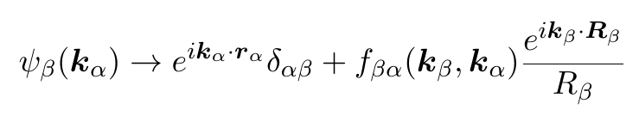
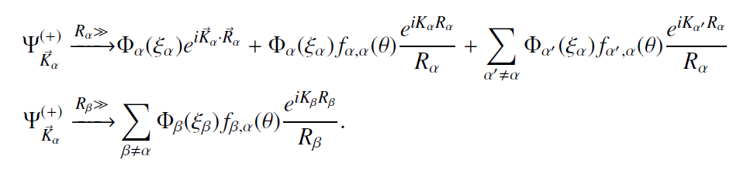
Coupled Channel
2. DWBA and CC
Up to now we only considered elastic scattering.
How to compute non-elastic reaction?
Extend the concept of S-matrix to multi-channel.
(Mass) partition : projectile (Zp,Ap) and target (Zt,At) combination
Channels : projectile and target quantum states (spin, parity, energy level )
In the same way, S-matrix becomes a matrix in channel space.

Slide 25
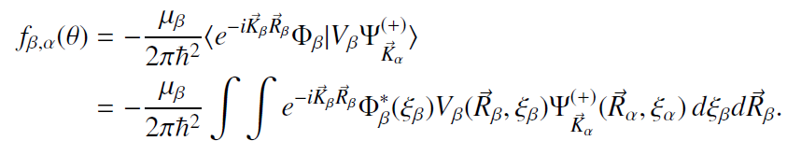
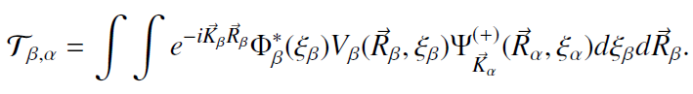
Coupled Channel
2. DWBA and CC
If we can compute the full scattering wave function,
Which include all possible channels,
We can obtain the reaction cross section.

Slide 26
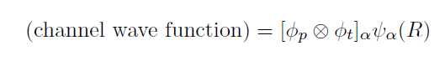


Coupled Channel
2. DWBA and CC
Simplification of many-body wave function :
sum of channel wave functions
(bound state wave functions of projectile and target)
and (wave function for relative motion)
Relative wave function determine the flux → cross section
b
a
A
B

Slide 27


Coupled Channel
2. DWBA and CC

Slide 28






Coupled Channel
2. DWBA and CC
S-matrix (for reaction)
Cross section (for reactions)

Slide 29

Coupled Channel
2. DWBA and CC
Unpolarized (spin averaged) cross section
All we need is to obtain wave function
(or scattering amplitude) for each channels.
How to get it?

Slide 30




Coupled Reaction Channel equation
2. DWBA and CC
Model space wave function
Suppose we separate full many-body Hamiltonian
Into (projectile)+(target)+(relative)
Note that the separation of
Full Hamiltonian into
Projectile and target
Is not unique.
Depends on Channel choice.

Slide 31


Coupled Reaction Channel equation
2. DWBA and CC
Model space wave function
Expand for each channels
Coupled channel equation

Slide 32




Coupled Reaction Channel equation
2. DWBA and CC
Left hand side
Ei : channel energy➔ kinetic energy in partition/channel
Separation of Hamiltonian is not unique
Right hand side

Slide 33



Coupled Reaction Channel equation
2. DWBA and CC
Introduce auxiliary potential in post form

Slide 34

Coupled Reaction Channel equation
2. DWBA and CC
Coupling = integral of bound state wave function and interaction
over internal coordinates
Simplification when coupling is weak → DWBA

Slide 35




DWBA
2. DWBA and CC
Consider two channels
This operator acts as Moeller operator
When acting on free |k1> state

Slide 36





DWBA
2. DWBA and CC
(LS equation for w.f.)

Slide 37




DWBA
2. DWBA and CC
Consider two channels
Ignoring V_{01}, assume small V_{10} coupling → DWBA
Note incoming wave boundary condition
< chi^{(-)}| In DWBA !

Slide 38





DWBA
2. DWBA and CC

Slide 39
DWBA
2. DWBA and CC
In DWBA, one does not need to solve coupled equation.
Solve distorted waves separately.
Calculate DWBA amplitude by integral
with distorted waves and coupling potential (and bound state waves)
over internal coordinates.
Now remaining problem is
(0) What is the distorting potential?
What is the coupling potential for specific reaction?
What is the bound state wave function?

Slide 40
Part 2.
Elastic, Inelastic, transfer reaction

Slide 41

Elastic scattering
3. Reactions
Typical energy dependence
Common to use ratio to Rutherford cross section
(Fig. from A.M. Moro’s lecture)

Slide 42



Optical potential
3. Reactions
Nuclear interaction
~ strong, attractive, short ranged.
Coulomb barrier
(Fig. from A.M. Moro’s lecture)

Slide 43




Optical potential
3. Reactions
Projection operator
Acts only on P(model space)
Complex
Energy Dependent
Negative imaginary potential
→ loss of a probability flux
from model space
5. non-local
Effective Hamiltonian
Theoretically we may compute effective Hamiltonian.
In practice, effective potential are fitted to experiments.
Optical potential in elastic channel simulates the neglected model space contributions

Slide 44
Optical potential
3. Reactions
It is common to use (phenomenological) optical potential to solve
Elastic scattering or get distorted waves.
Only for Elastic channel
Coulomb + Complex nuclear interaction
→ complex phase shift, |s|<1.
→ absorption (disappearance in elastic channel)

Slide 45





Optical potential
3. Reactions
It is common to use (phenomenological) optical potential to solve
Elastic scattering or get distorted waves.
Typically, Woods-Saxon form : Depth, Radius, diffuseness
Surface (derivative)
Spin-orbit interaction
Definition of (reduced) radius
is not unique.

Slide 46

ReactionGUI code
3. Reactions
https://github.com/alphacentaury-github/ReactionGUI
Written by Y.-H.Song and I.J.Shin.
Combine GUI + FRESCO + other reaction codes
Require python 3.x and several packages.

Slide 47



ReactionGUI code
3. Reactions
Written by I. J. Thompson
Very Powerful, Modern ,
General purpose Reaction code.
(many useful nuclear data, optical potentials, codes…)
(For Fusion reaction)
(Knockout reaction)

Slide 48

ReactionGUI code
3. Reactions
File:
Save/Load
Input parameter values
Three tabs
Partition
Structure Model
Potentials/compute/plot

Slide 49

ReactionGUI code
3. Reactions
Neutron : 1n
Proton : 1H
Deuteron : 2H
projectile
target
Incident Energy/
Type of reaction
kinematics

Slide 50


ReactionGUI code
3. Reactions
Get kinematics
button

Slide 51

ReactionGUI code
3. Reactions

Slide 52

Global optical potential
3. Reactions
Get Global OMP
Get optical potential parameters
from RIPL-3 If available.
(p,n, 2H, 3H, 4He projectiles)

Slide 53

ReactionGUI code
3. Reactions
Various potential shapes

Slide 54

Double Folding potential
3. Reactions
Typically, optical potentials are fitted to experimental data.
If experimental data is not available?
Either use global optical potential or folding potential.
NN interaction should be an effective interaction.
M3Y or density-dependent M3Y interaction are commonly used.

Slide 55

Double Folding potential
3. Reactions
Get Folding V
Get density profile from HFB-14 results If available.
(From RIPL-3)
Or User input of density profile
* Because of double folding, it requires density even for proton.

Slide 56



Fitting OMP
3. Reactions
Exp
data
Fit
Elastic
OMP

Slide 57

Fitting OMP
3. Reactions
Result of fitting
At the moment, no automatic update of parameter after fitting available

Slide 58
Inelastic scattering
3. Reactions
Inelastic scattering : A+B → A’+B* (no rearrangement of particles )
From the energy and momentum, angular momentum conservation.
If one measure the energy and angle distribution of projectile,
One can get energy and angular momentum of excited states.
Transferred energy.
transferred orbital angular momentum ΔL

Slide 59
Inelastic scattering
3. Reactions
DWBA amplitude
Inelastic scattering : A+B → A’+B* (no rearrangement of particles )
One have to integrate with
Entrance/exit channel distorted wave functions
Projectile-target transition coupling
= (entrance/exit channel bound state wave functions)
+ (interaction which can cause transition)
integrate with internal degrees of freedom.
One can multipole expand the coupling:
transferred orbital angular momentum : ΔL
spin angular momentum : ΔS
total angular momentum : ΔJ

Slide 60


Inelastic scattering
3. Reactions
Simple models of inelastic excitations.
Collective excitation model :
Treat the excitation of a nucleus as
a transition from one collective state to another collective state.
|I M> -> |I’ M’>
Rotational model or Vibrational model

Slide 61



Inelastic scattering
3. Reactions
Simple models of inelastic excitations.
(2) Single particle excitation model:
Treat a nucleus as a bound state of core + valence.
Nuclear excitation = change of bound state wave function of valence particle.
n
p
c’
t=n+c’

Slide 62


Collective Rotation model
3. Reactions
Rigid Rotor → deformation of a nucleus.
Hamiltonian depends on the
Collective angle coordinates.(Euler angle)

Slide 63


Collective Rotation model
3. Reactions
In many cases,
Axially symmetric deformed nuclei
are considered.
Consider Rotation perpendicular to
Symmetry axis.
Angular momentum operator R
For collective Rotation
Acts on collective coordinates
i.e Euler angle.

Slide 64

Collective Rotation model
3. Reactions
Rotational state is specified by I, M, K
Wave function of rigid rotor (analogy of spherical harmonics)
Omega = Euler angle between body-fixed z’-axis and laboratory z-axis.
(two-fold degeneracy of clock-wise, counter-clock-wise rotation)
Even-Even nuclei : intrinsic spin=0 → K=0
only even number of I are possible, I = 0,2,4…
Odd nuclei : K is integer or half-integer
Rotational Band I = K, K+1, K+2 … are possible

Slide 65






Collective Rotation model
3. Reactions
We have wave function of rigid rotor.
Excitation corresponds to changes of |IMK > → |I’ M’ K’>
What makes the inelastic transition?
Change of distance between projectile-target surface
Deformed potential
For axial symmetric nuclei,
Deformation length = R0*a_{q0}

Slide 66





Collective Rotation model
3. Reactions
Multipole expansion of coupling interaction
Coupling potential between channels ( comes from deformation of Coulomb and Nuclear)

Slide 67

Collective Rotation model
3. Reactions
Reduced Coulomb transition probability
May be obtained from electron scattering experiment

Slide 68



Collective Rotation model
3. Reactions

Slide 69





Collective Vibration model
3. Reactions
Vibration in Q.M. → Oscillator or phonon
If one treat, parameter as operators with commutation relation.
Redefine, creation, annihilation operator
Hamiltonian of phonon

Slide 70




Collective Vibration model
3. Reactions
If two phonons of the same kind
→ Only Even I is possible.
Coupling potential are similar to Rotor model.
Except
Degeneracy is broken by
anharmonic interactions

Slide 71

Coupled Channel calculation
3. Reactions
If the coupling between channels is weak
→ DWBA
If several channels are strongly coupled →
Coupled channel calculation

Slide 72

ReactionGUI for collective inelastic scattering
3. Reactions
Inelastic scattering case
Spin/parity of excited state
Excitation energy
ReactionGUI use DWBA
Coupled Channel calculation can be done with FRESCO

Slide 73


ReactionGUI for collective inelastic scattering
3. Reactions
For the moment,
Only Rotor Model
Is available.
(for collective excitation
model)
Deformation length
Is calculated
With r0=1.2

Slide 74

ReactionGUI for collective inelastic scattering
3. Reactions

Slide 75





Inelastic scattering (cluster model)
3. Reactions
v
Excitation = s.p.(cluster) excitation
r
c
R
T

Slide 76
Inelastic scattering (cluster model)
3. Reactions
One can introduce auxiliary optical potential for entrance/exit channel.
Then transition potential becomes
v
r
c
R
T
Instead of using bound w.f. as input,
Typically, one provide
Binding potential
N,L,J of bound state
Binding energy or separation energy
and adjust depth of binding potential
(well depth prescription)
Thus, instead of many-body wave function,
Use a single particle wave function.
In cluster model,
valence particle
core
Interactions
Bound w.f.

Slide 77




Overlap function
3. Reactions
Spectroscopic amplitude
Spectroscopic factors
To be exact, Anti-symmetry
of wave function have to be considered
(From Lecture of J.Tostevin)

Slide 78

Overlap function
3. Reactions
(From Lecture of J.Tostevin)

Slide 79

How many node for cluster?
3. Reactions
(From Lecture of J.Tostevin)

Slide 80

How many node for cluster?
3. Reactions
(From Lecture of J.Tostevin)

Slide 81

Asymptotic Normalization Coefficient
3. Reactions
From the Separation energy and Coulomb interaction,
At long distance separation, we can expect the overlap function
Would be proportional to Whittaker function.
Coefficient is called ANC
It may be calculated from many-body theory.
If we approximate overlap function as normalized s.p. w.f.,
ANC ~ (spectroscopic amplitude)
*(normalized s.p. w.f. at large R )/(Whittaker function at large R)
~ (spectroscopic amplitude) *( s.p. ANC)

Slide 82



Transfer Reaction
3. Reactions
p(=c+n)+c’ → c+t(=c’+n)
In rearrangement,
initial and final partition is different.
n
Channel Coupling
In Prior form or Post form
c
c’
p=c+n
t=n+c’
Remnant term are small in many case
Some pair interaction is a part of internal Hamiltonian of projectile or target.
Where V_{t,p} are binding potential
U_{cc’} are core-core potential
U_{I,f} are optical potential

Slide 83


Transfer Reaction
3. Reactions
(d,p) reaction case:
In post form
assume remnant correction is small → Coupling comes from V_{np}
Zero range approximation : V_pn(r)*phid(r) -> D_0*delta(r)

Slide 84


Transfer Reaction as a spectroscopic tool
3. Reactions
Transfer reaction cross section is sensitive
To the transferred angular momentum
(1) By analyzing angular distribution,
one can determine
the transferred orbital angular momentum
The quantum number of s.p. states
(2) In a s.p. picture,
one can extract S.F. from experiments
→ Spectroscopic information

Slide 85

Transfer Reaction in ReactionGUI
3. Reactions

Slide 86

Transfer Reaction in ReactionGUI
3. Reactions
N, L, J of cluster state
S.A. = spectroscopic
amplitude
Post/prior form

Slide 87

Transfer Reaction in ReactionGUI
3. Reactions
Bound state
Wave functions
Are obtained in
Well-depth
Prescription
Always check
Parameters.
No automatic
Determination
Of potential parameter
Is Available.
One can export
The result of DWBA
Calculation as a file.

Slide 88
Part 4.
Break up, CDCC, ADWA

Slide 89
Weakly bound nuclei
4. Reactions
Weakly bound nuclei :deuteron, Halo nuclei, nuclei near dripline
Large interaction cross section in nuclear collision at high energies
(→can be interpreted as a large radius, 6He, 11Li, 14Be )
Abnormal elastic cross section
(→ Disappearance of Fresnel peak near barrier energy)
Enhanced near-threshold breakup cross section in Coulomb dissociation experiments of neutron-halo nuclei.
Narrow momentum distributions of residues when fast nucleon is removed.

Slide 90

Weakly bound nuclei
4. Reactions
(From slides of A.M. Moro)

Slide 91

Break up
4. Reactions
(From slides of A.M. Moro)

Slide 92

Continuum W.f.
4. Reactions
Unlike bound state wave function,
Continuum wave function does not
Vanish at large distance.
Non-normalizable
(Stable) Coupling is difficult to obtain
There are infinite number of energies
Continuum discretization
(1) Pseudo States method
(2) Bin method
(From slides of A.M. Moro)

Slide 93

Continuum discretization
4. Reactions
(From slides of J. Tostevin)

Slide 94

Continuum discretization
4. Reactions
(From slides of J. Tostevin)

Slide 95




CDCC
4. Reactions
(From slides of A. Moro)

Slide 96

CDCC
4. Reactions
CDCC describes
Elastic scattering
Breakup
At the same time
One have to specify how the bin is prepared.
FRESCO
Can compute
CDCC
Implementation of CDCC
In ReactionGUI is planned.
(From slides of A. Moro)

Slide 97


CDCC
4. Reactions
d + 58Ni
Elastic scattering
6Li = alpha + d
Importance of break up channels
For weakly bound nuclei.
(From slides of A. Moro)

Slide 98

ADWA for transfer reaction
4. Reactions
For Halo or weakly bound nuclei , break up channel coupling is important.
→ break up channel can affect transfer reaction.
One can obtain the effects of breakup channels to transfer reaction
By using CDCC-BA
CDCC-BA = (coupled channel equations for elastic+break up channels)
+ DWBA for transfer channel.
Another way to include break up channels in transfer reaction is
Adiabatic Distorted Wave Born Approximation
(From slides of A. Moro)

Slide 99




ADWA for transfer reaction
4. Reactions
For transfer reaction,
it is important to obtain wave function in short range.
Optical potential only imply it gives good phase shift at large separation.
One needs a good approximation of full wave function in the range of interaction.
Adiabatic approximation: slow process → frozen
(From slides of A. Moro)

Slide 100





ADWA
4. Reactions
Adiabatic approximation
Treat “r” as a parameter.
(frozen during reaction.)
In zero-range approximation, wave function at r=0 is important

Slide 101



ADWA
4. Reactions
Solving this equation is equivalent to solve distorted Wave with adiabatic potential.
Jhonson-Sopper
Zero range
Adiabatic potential
(Finite range version.)
Compute transfer reaction by using
Adiabatic Wave function.
Note that Adiabatic potential is not for elastic scattering.

Slide 102
Part 5.
Knockout, Fusion

Slide 103
Knockout in Eikonal approximation
4. Reactions
Knockout reaction : combination of break up and transfer
A (B, c) X , B = c + n
Measure momentum distribution of remnant.
Reflect the momentum distribution of nucleon in the projectile.
( In Projectile rest frame, momentum of c = -(momentum of nucleon) )
Contributions
Elastic Break up , X= n + A
Inelastic Break up , X = n’ + A*
Transfer (stripping) , X = (n+A)
Knockout reaction can be calculated with
DWIA
Transfer to continuum ( similar to CDCC)
Eikonal method (~ WKB approximation)

Slide 104

Knockout in Eikonal approximation
4. Reactions
(Slide from J. Tostevin)

Slide 105

Knockout in Eikonal approximation
4. Reactions
If we can obtain semi-classical S(b), S-matrix
we can compute cross section.
S(b) corresponds to the phase modification due to interaction.
(Slide from J. Tostevin)

Slide 106



Knockout in Eikonal approximation
4. Reactions
At high energy, trajectory will be similar to straight line.
Though trajectory is fixed,
Wave function can change it’s phase
After scattering.
Phase shift depends on impact parameter
→ Wave front change, angular distribution.
This gives eikonal phase shift

Slide 107





Knockoout in Eikonal approximation
4. Reactions
Eikonal S-matrix.

Slide 108

Knockoout in Eikonal approximation
4. Reactions
Eikonal approximation for composite particle

Slide 109


Knockoout in Eikonal approximation
4. Reactions
MOMDIS code
In Eikonal approximation,
S(b) can be thought as a survival amplitude
Elastic S-matrix

Slide 110

Knockoout in Eikonal approximation
4. Reactions
(From Lecture of A. M. Moro)

Slide 111






Knockoout in Eikonal approximation
4. Reactions
For elastic break up (1) final state is continuum wave
(2) both core and valence have to survive
Or Diffractive breakup
Stripping means removal of valence particle
Probability of v-removal
=
Inelastic break up
(v-removal)
Or
Stripping
Cross section

Slide 112



Knockoout in Eikonal approximation
4. Reactions
Assume no spin dependence
Input are (1) bound state wave function
(2) S-matrix of nucleon-target
(3) S-matrix of core-target

Slide 113

ReactionGUI with MOMDIS
4. Reactions

Slide 114

ReactionGUI with MOMDIS
4. Reactions

Slide 115

Fusion reaction
4. Reactions
One can obtain fusion(absorption) cross section by using
Complex optical potential
Quantum tunneling with real potential.
(from lecture of K. Hagino)

Slide 116

Fusion reaction
4. Reactions
(from lecture of K. Hagino)

Slide 117

Fusion reaction
4. Reactions
(from lecture of K. Hagino)

Slide 118

Fusion reaction
4. Reactions
CCFULL code compute fusion cross section
By solving Coupled Channel equation
With incoming wave boundary condition.
Fusion cross section ~ sum of penetration probability in each channels
CCFULL can include
Excited states in Rotor model
Excited states in Vibration model

Slide 119




Fusion reaction
4. Reactions

Slide 120

Fusion reaction
4. Reactions
CCFULL code
Is interactive

Slide 121

Thank you

